Slide 1
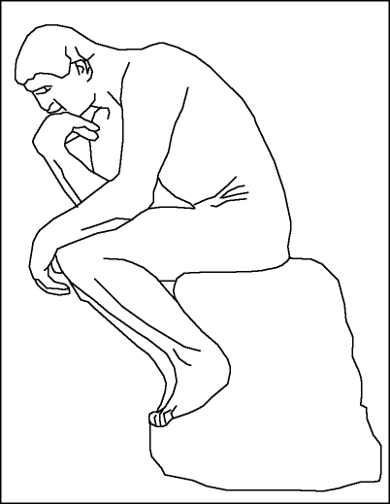
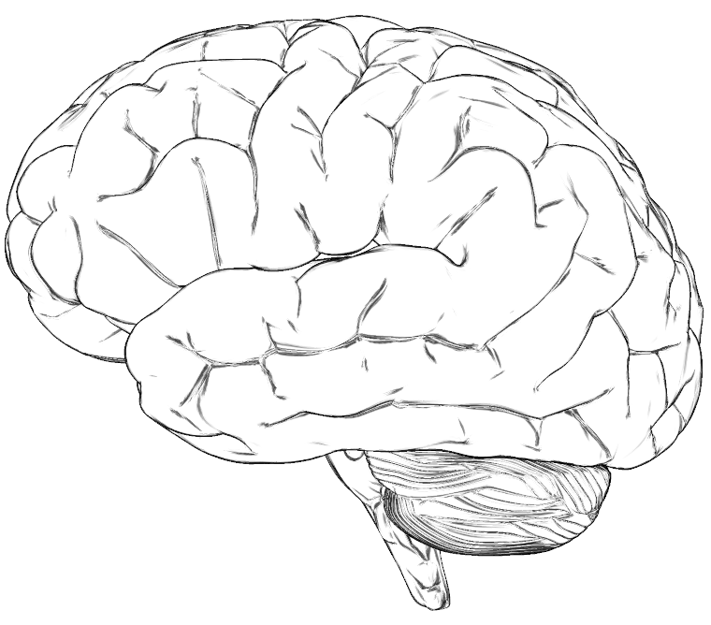
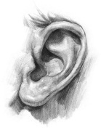
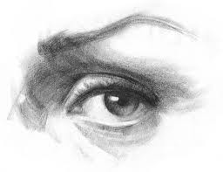
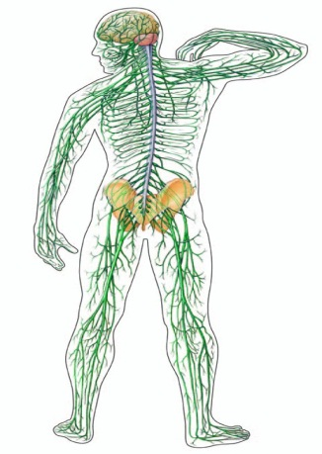
Functional Diagram of Brain
- Dr Kingsley Mudd MBBS FRACGP
LOGIC
ANALYZING
PLANNING
PROBLEM-SOLVING
IMAGINATION
AWARENESS
MEMORY
EMOTION
SENSATIONS

Slide 2
Functional Diagram of Brain
LOGIC
ANALYZING
PLANNING
PROBLEM-SOLVING
IMAGINATION
AWARENESS
MEMORY
EMOTION
SENSATIONS
After Mindfulness Training

Slide 3
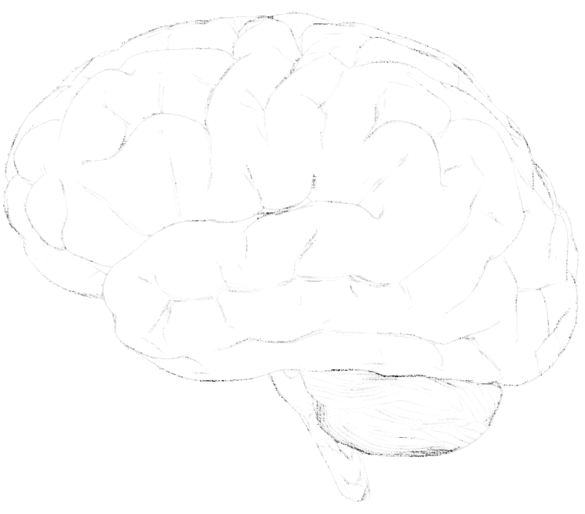
Functional Diagram of Brain
- Dr Kingsley Mudd MBBS FRACGP
THOUGHT
IMAGINATION
HUB OF AWARENESS
(Attention)
MEMORY
EMOTION
SENSATIONS
Ref – The Whole Brain Child, Siegel & Bryson

